Slide 1
wanderlust bundle
Jayasri Maditati

Slide 2








Can i just have fun horseriding,kayaking, fishing or skiing
Should I just go scenic driving? CadesCove was spectacular.
Ahh! Last year, I did Half Dome. Can I try similar???

Slide 3
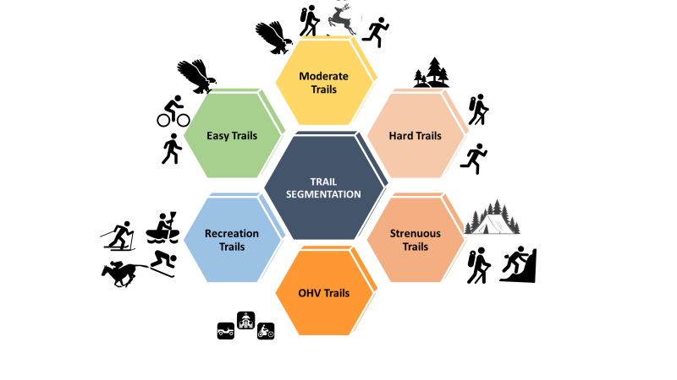
K-Means Clustering

Slide 4
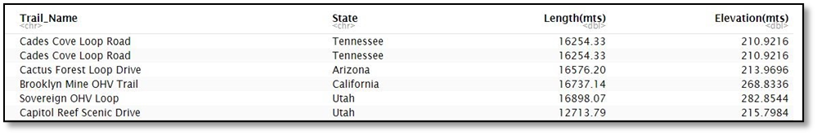
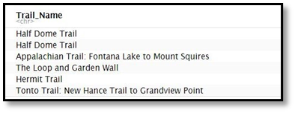
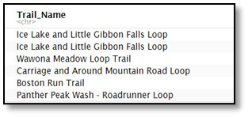
RESULTS
Cades Cove Loop Road is mainly for Off-Road, Scenic Driving,Road biking and Bike Touring. So enjoy the spectacular views. Also Here are the few trails you would like to try.
Half Dome Trail is a Hard and Challenging Trail. Don’t forget to backpack and carry lots of fluids. This is mainly for hiking, bird watching and views
If you just want to have some fun with interesting activities like paddle-sports, canoeing,fly-fishing,skiing & snowshoeing.Here are few Trails you would like to try

Slide 5
Thank You !!!

